Slide 1
Lesson objective
Need whiteboards
Title: Expressions
Aim:
Write expressions for the perimeter of rectangles
Identify and collect like terms
Plan:
Daily review
  BIMDAS
  Indices
Perimeter and algebra

Slide 2
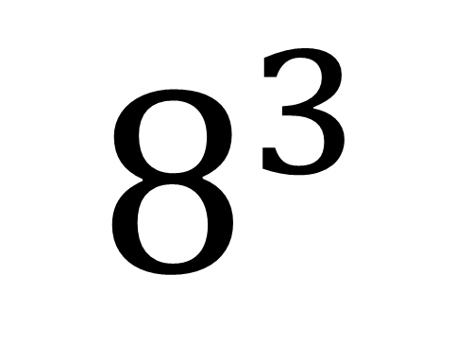
The index number
(or exponent, indices or power)
How many of the Base number we need in the multiplication
The BASE number
(BIG IS BASE)
It is the number that is repeated in the multiplication.
$$8^{3}$$
= 8 x 8 x 8

Slide 3

Whiteboards
Expand the following
$8^{4}$
$9^{5}$
$3^{2}$
$7^{3}$

Slide 4
Your turn – whiteboards
Simply (put into index notation)
7 x 7 x 7
2 x 2 x 2 x 2 x 2 x 2
4 x 4 x 4 x 4 x 4 x 4 x 4 x 4

Slide 5


Daily review: BIMDAS
I do
We do
$15 ÷3+4 ×2=$
$\left(17 −9\right)−(−24) ÷ 4^{2}$
$10 ÷2+4 ×5=$
$12 ÷4 ×\left(7 −5\right)+ 2^{3}$

Slide 6
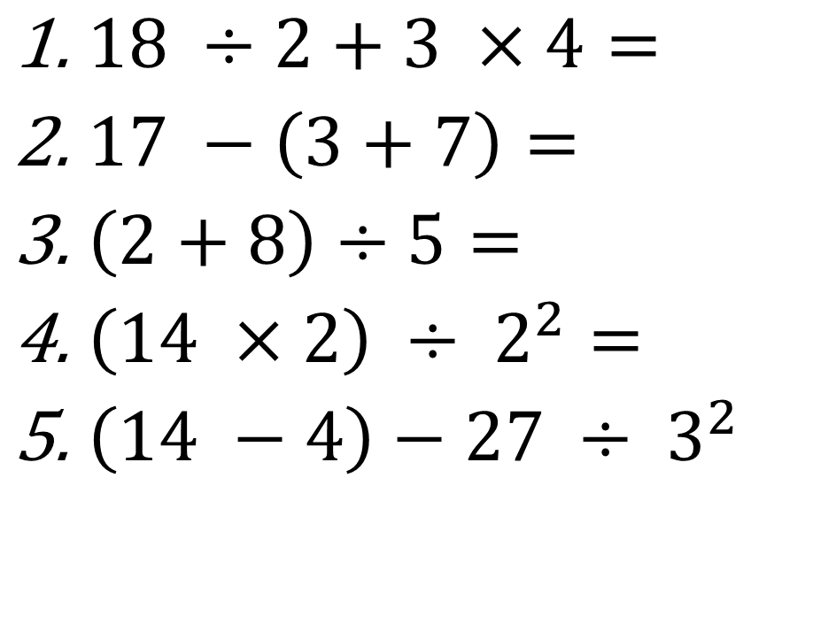
You do (exercise books)
Copy the question
Underline the first operation and replace.
Continue – show all working.
$18 ÷2+3 ×4=$
$17 −\left(3+7\right)=$
$\left(2+8\right)÷5=$
$\left(14 ×2\right) ÷ 2^{2}=$
$\left(14 −4\right)−27 ÷ 3^{2}$

Slide 7
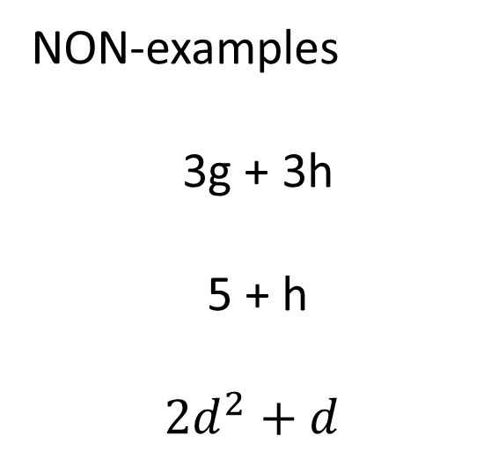
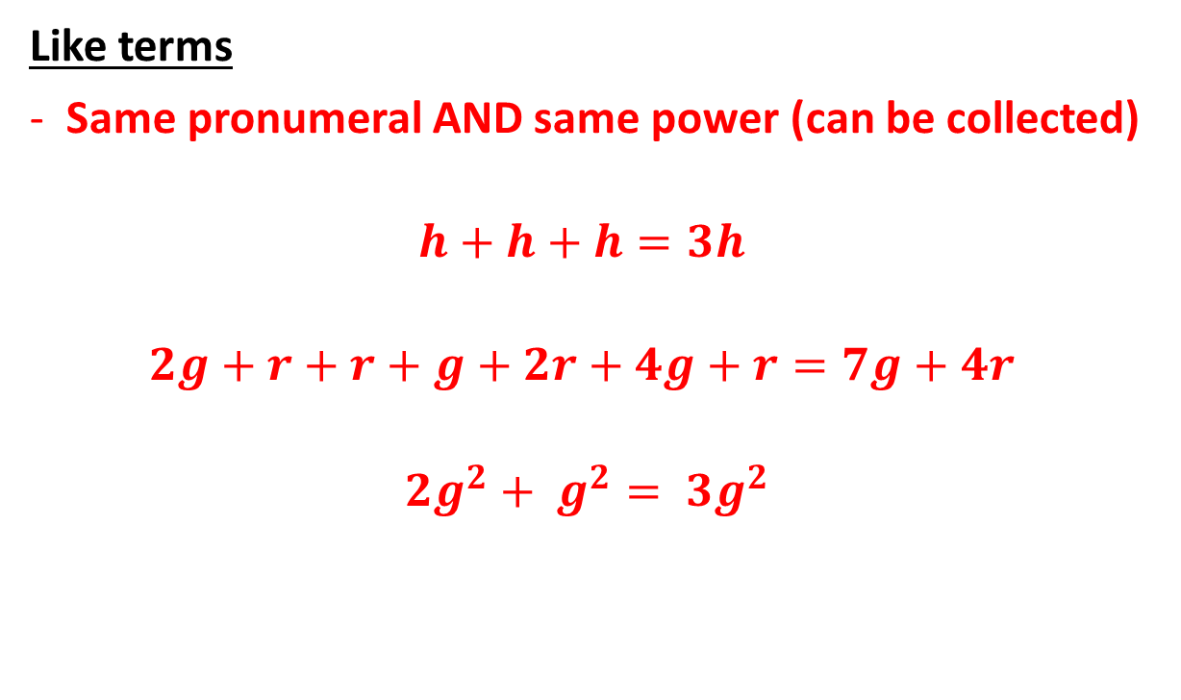
Terminology
Like terms
Same pronumeral AND same power (can be collected)
$$h+h+h=3h$$
$$2g+r+r+g+2r+4g+r=7g+4r$$
$${2g}^{2}+ g^{2}= {3g}^{2}$$
NON-examples
3g + 3h
5 + h
$${2d}^{2}+d$$

Slide 8


Slide 9
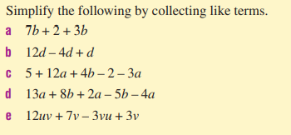

Slide 10
Collect like terms
Simplify by collecting like terms:
4g + 5g
2f + f + 2f
9h + 2h + 5
3e + 3e + 5d + d
2d + 3h + 4d – h

Slide 11
Writing expression
The perimeter of a shape is the total length of the boarder forming the shape.
E.g., the perimeter of this square is….
5cm

Slide 12
Writing expression
Expressions are used when we don’t know the value of something.
E.g., the perimeter of this square is….
2g

Slide 13
Perimeter of rectangles
2g + f
2f
3f +1
5g + 2f
5g +2
2g

Slide 14
Whiteboards
Write an expression for the perimeter of this shape:
3d
3d
3d
3d

Slide 15
Whiteboards
Write an expression for the perimeter of this shape:
5h + 4
3h
3h
5h + 4

Slide 16
Whiteboards
Write an expression for the perimeter of this shape:
5g
2g + 2
2g + 2

Slide 17
Whiteboards
Write an expression for the perimeter of this shape:
2f + 3g
3f + g
3f + g
2f + 3g

Slide 18
Individual practice
Page 215
Questions:
1 – 3 and 7 – 10 and 12
Challenge question 14

Slide 19
Reflection
Aim:
Write expressions for the perimeter of rectangles
Identify and collect like terms

